Slide 1

Netflix Stock Analysis: 2017
An equity study including Comparison Against the DJIA

Slide 2
Included charts
Distribution of Netflix Stock Prices
Netflix Revenue & Earnings
Netflix Actual vs. Estimated Earnings per Share
Netflix & DJI Growth
Netflix & DJI Growth (Rebased)
Created by Michael Cassidy for the Stock Profile Team

Slide 3
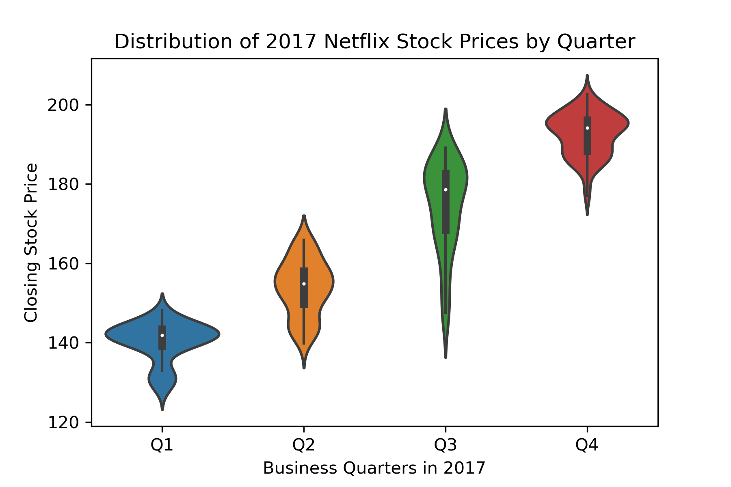
Distribution of Netflix stock prices: 2017
Netflix continued to grow over 2017.
2017 Low: 127.49
2017 High: 202.68
Q’s 1, 2, and 4 saw ranges of ~30 points.
Q3 saw a strong increase in volitility with a range closer to ~60 points.

Slide 4
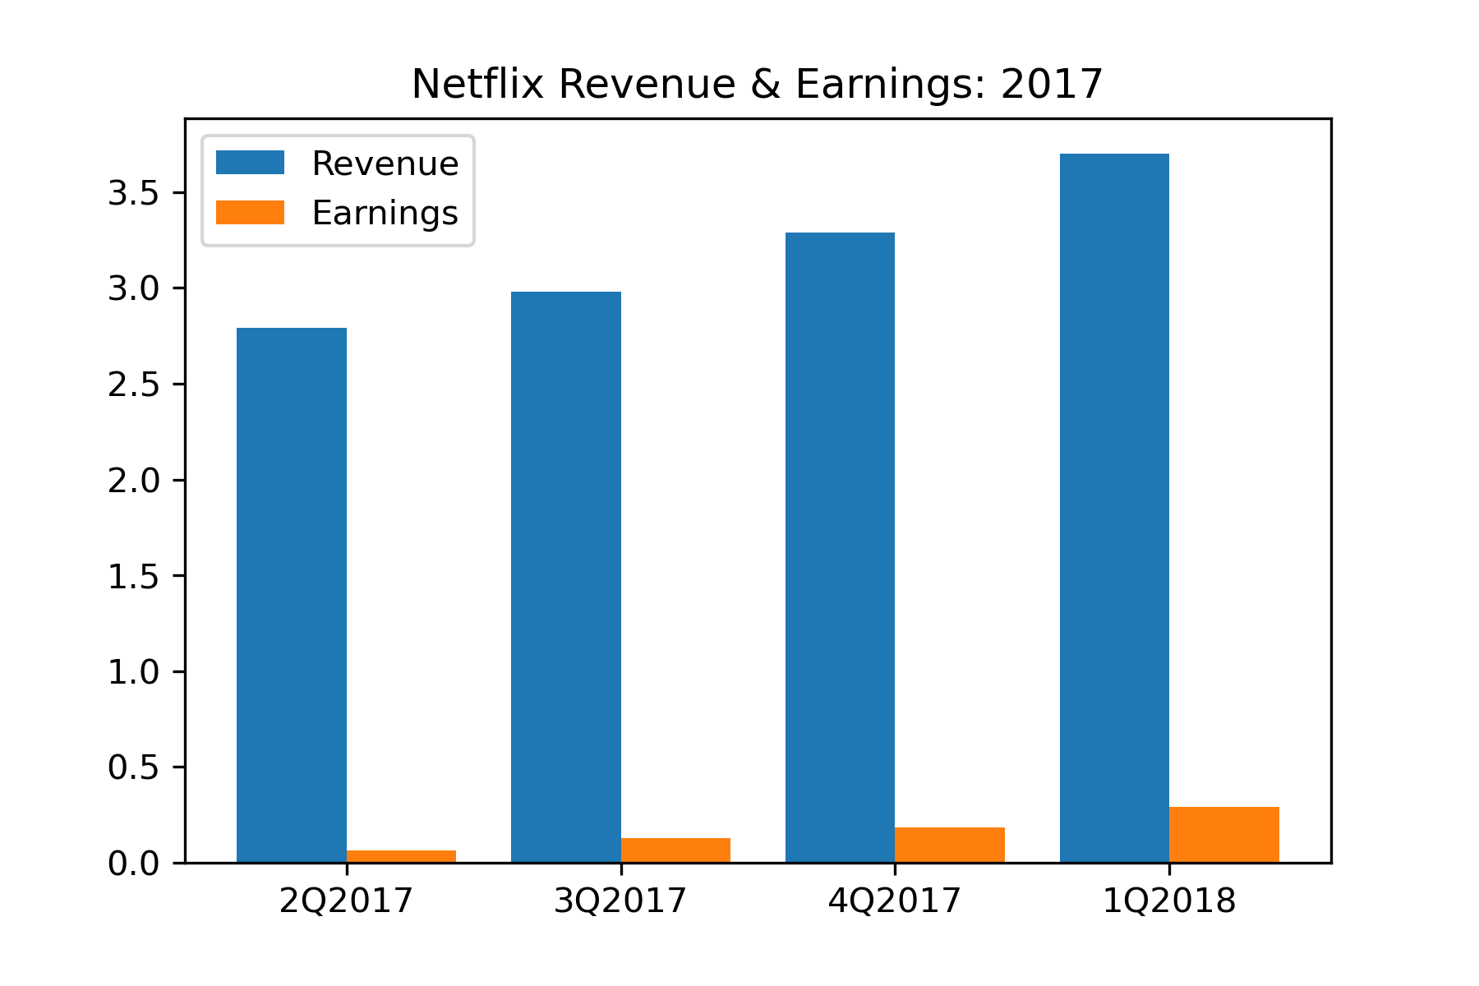
Revenue & Earnings for Netflix: 2017
Both earnings and revenue grew through 2017.
Revenue grew at a faster rate than earnings.
While earnings as a share of revenue averaged 5% over the year, it also shows strong signs of growth (starting at 2.35% in Q1 and ending at 7.84% in Q4).

Slide 5
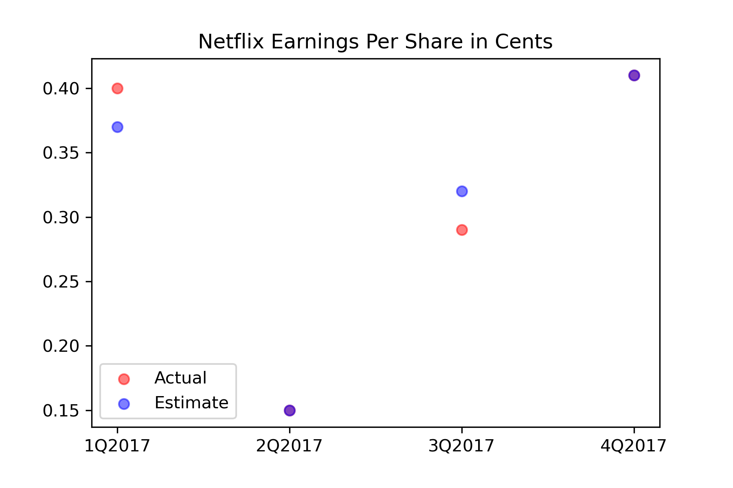
Netflix Actual vs Estimated Earnings per share: 2017
The quarterly estimates appear highly accurate and positive.

Slide 6
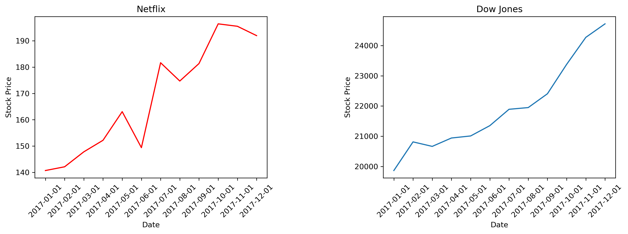
Netflix and Dow jones industrial average growth: 2017

Slide 7
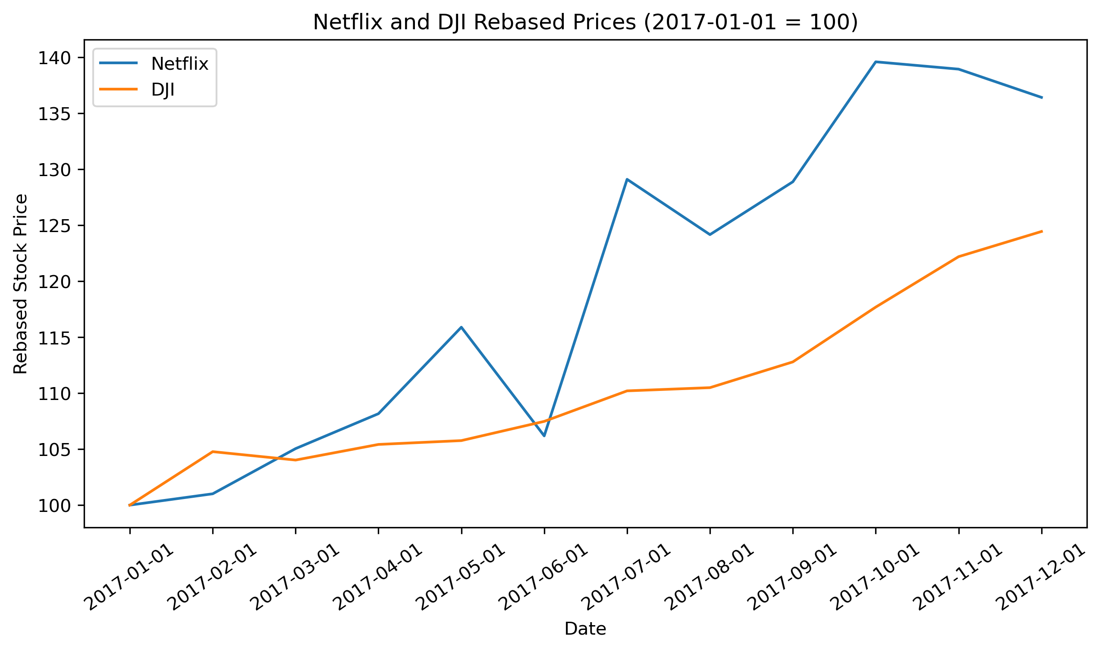
Netflix vs djia growth - rebased
Rebasing the timeseries allows us to make an accurate comparison of growth.
Netflix grew 36.42% over 2017.
The DJIA grew 24.44% over the same period.
Netflix exhibited far more volatility.

